Slide 1
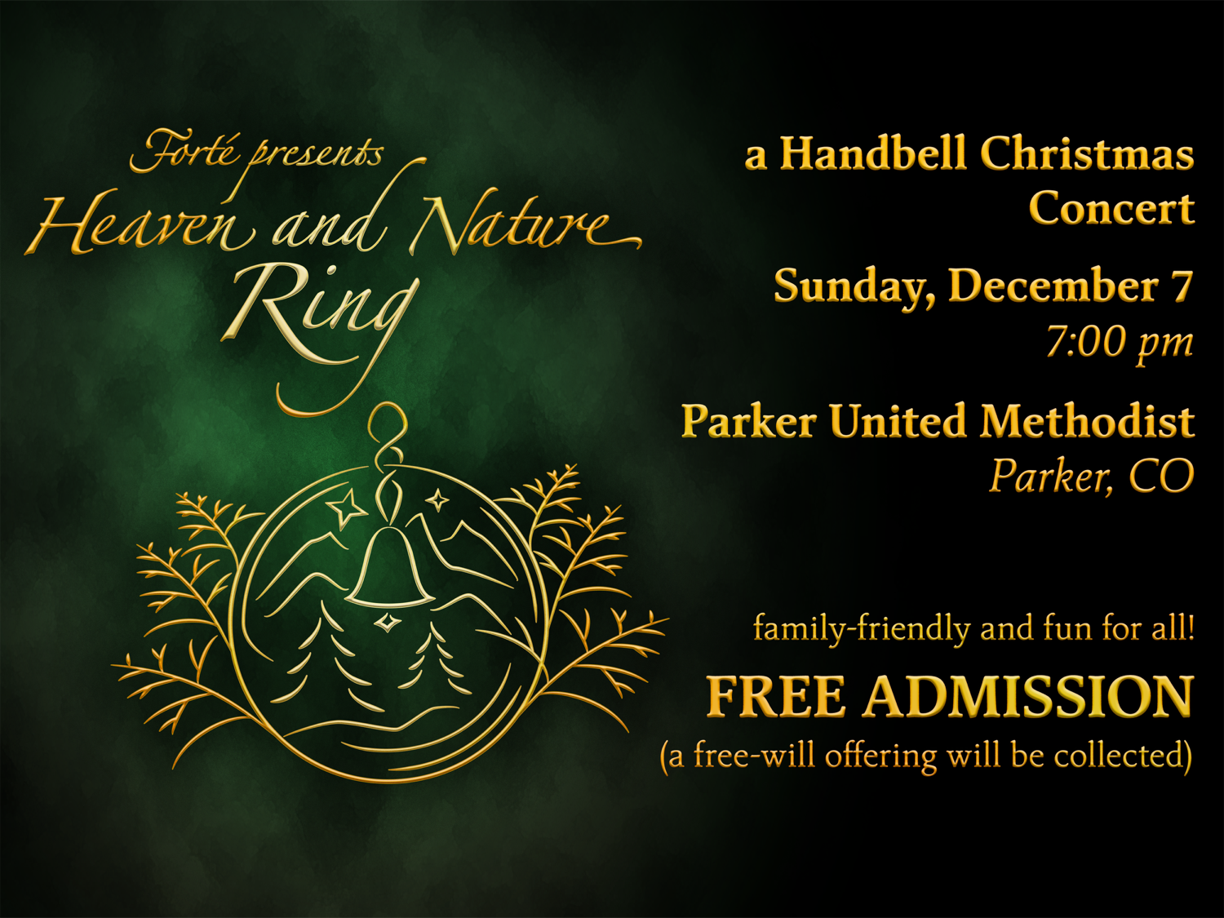
Notes:
For church announcements:
We’re hosting the Forté Handbell Quartet for a Christmas concert!
With "Heaven and Nature Ring", Forté invites you into an uplifting start to the Christmas season, featuring some of their favorite arrangements of Christmas carols and some exciting and beautiful new selections.
Admission is FREE (a free-will offering will be collected), and seating is first-come, first-served, so come early to ensure you get a good spot.
Spread the word, invite your friends and family, and come ring in the Christmas season with Forté!
For more information, see Forté’s website, ForteHandbells.org

